Slide 1
Hierarchical Attention Networks From Scratch
Shang Gao

Slide 2
Background
National Cancer Institute has asked Oak Ridge National Lab to develop a program that can automatically classify cancer pathology reports
Pathology reports are what doctors write up when they diagnose cancer, and NCI uses them to calculate national statistics and track health trends
Challenges:
Different doctors use different terminology to label the same types of cancer
Some diagnoses may reference other types of cancer or other organs that are not the actual cancer being diagnosed
Typos
Task: given a pathology report, teach a program to find the type of cancer, location of cancer, histological grade, etc

Slide 3
Background
Many types of classifiers were tested:
Traditional machine learning classifiers: Naive Bayes, Random Forests, and XG-Boost
Traditional machine learning classifiers require manually defined features, such as bag of words or tf-idf
Deep learning methods: convolutional neural networks and recurrent neural networks
Given enough data, deep learning methods can learn their own features, such as which words or phrases are important
Hierarchical Attention Network is a relatively new deep learning model that came out last year and is one of the top performers

Slide 4
Goals
Learn how Hierarchical Attention Networks work from scratch
Review of Basic Neural Networks
Recurrent Neural Networks
Advanced RNN Architectures
Long-Short-Term-Memory
Gated Recurrent Units
RNNs for Natural Language Processing
Word Embeddings
NLP Applications
Attention Mechanisms
Hierarchical Attention Networks

Slide 5
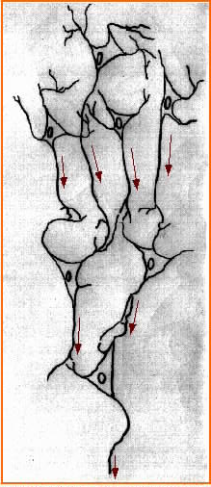
What’s a Neural Network?
Artificial neural networks are based on how real neurons operate
A neuron receives input signals from other neurons in the form of electric impulses
If the total electric impulses received exceeds a specific threshold, it “fires”, sending an electric impulse of its own
Other neurons then receive that electric impulse, and they may then send our their own impulses, and so on
Depending on which neurons fire, an action is executed or a decision is made

Slide 6

What’s a Neural Network?
Artificial neural networks operate on the same principle
Each artificial neuron receives input from previous neurons
Each neuron processes all input received using an activation function (e.g. sigmoid), which determines how much signal to pass on
The neurons at the very end determine the outcome or decision

Slide 7
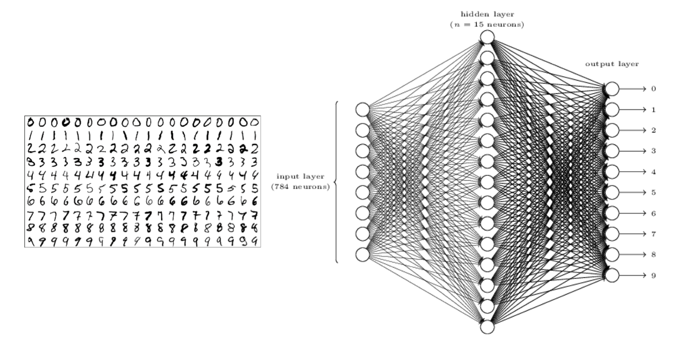
Neural Network Example

Slide 8
Recurrent Neural Networks
Recurrent Neural Networks are designed for time-series data (e.g. weather, stock market data, speech audio, natural language)
In a regular feedforward network, each neuron takes in inputs from the neurons in the previous layer, and then pass its output to the neurons in the next layer
The neurons at the end make a classification based only on the data from the current input

Slide 9

Recurrent Neural Networks
In a recurrent neural network, each neuron takes in data from the previous layer AND its own output from the previous timestep
The neurons at the end make a classification decision based on NOT ONLY the input at the current timestep BUT ALSO the input from all timesteps before it
Recurrent neural networks can thus capture patterns over time

Slide 10
Recurrent Neural Networks
In the example below, the neuron at the first timestep takes in an input and generates an output
The neuron at the second timestep takes in an input AND ALSO the output from the first timestep to make its decision
The neuron at the third timestep takes in an input and also the output from the second timestep (which accounted for data from the first timestep), so its output is affected by data from both the first and second timestep

Slide 11

Recurrent Neural Networks
Traditional Neuron: output = sigmoid(weights * input + bias)
Recurrent Neuron: output = sigmoid(weights1 * input + weights2 * previous_output + bias) or output = sigmoid(weights * concat(input, previous_output) + bias)

Slide 12
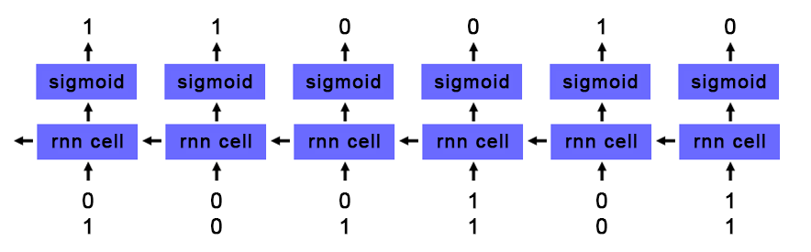
Toy RNN Example Adding Binary
At each timestep, RNN takes in two values representing binary input
At each timestep, RNN outputs the sum of the two binary values taking into account any carryover from previous timestep

Slide 13
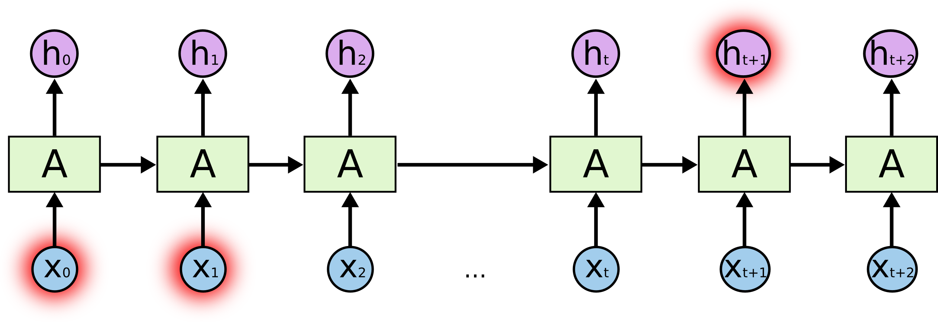
Problems with Basic RNNs
In a basic RNN, new data is written into each cell at every timestep
Data from timesteps very early on get diluted because they are written over so many times
In the example below, data from the first timestep is read into the RNN
At each subsequent timestep, the RNN factors in data from the current timestep
By the end of the RNN, the data from the first timestep has very little impact on the output of the RNN

Slide 14
Problems with Basic RNNs
Basic RNN cells can’t retain information across a large number of timesteps
In practice, RNNs can lose data in as few as 3-5 timesteps
This is causes problems on tasks where information needs to be retained over a long time
For example, in natural language processing, the meaning of a pronoun may depend on what was stated in a previous sentence

Slide 15

Long Short Term Memory
Long Short Term Memory cells are advanced RNN cells that address the problem of long-term dependencies
Instead of always writing to each cell at every time step, each unit has an internal ‘memory’ that can be written to selectively

Slide 16

Long Short Term Memory
Input from the current timestep is written to the internal memory based on how relevant it is to the problem (relevance is learned during training through backpropagation)
If the input isn’t relevant, no data is written into the cell
This way data can be preserved over many timesteps and be retrieved when it is needed

Slide 17

Long Short Term Memory
Movement of data into and out of an LSTM cell is controlled by “gates”
The “forget gate” outputs a value between 0 (delete) and 1 (keep) and controls how much of the internal memory to keep from the previous timestep
For example, at the end of a sentence, when a ‘.’ is encountered, we may want to reset the internal memory of the cell

Slide 18

Long Short Term Memory
The “candidate value” is the processed input value from the current timestep that may be added to memory
Note that tanh activation is used for the “candidate value” to allow for negative values to subtract from memory
The “input gate” outputs a value between 0 (delete) and 1 (keep) and controls how much of the candidate value add to memory

Slide 19

Long Short Term Memory
Combined, the “input gate” and “candidate value” determine what new data gets written into memory
The “forget gate” determines how much of the previous memory to retain
The new memory of the LSTM cell is the “forget gate” * the previous memory state + the “input gate” * the “candidate value” from the current timestep

Slide 20

Long Short Term Memory
The LSTM cell does not output the contents of its memory to the next layer
Stored data in memory might not be relevant for current timestep, e.g., a cell can store a pronoun reference and only output when the pronoun appears
Instead, an “output” gate outputs a value between 0 and 1 that determines how much of the memory to output
The memory goes through a final tanh activation before being passed to the next layer

Slide 21

Gated Recurrent Units
Gated Recurrent Units are very similar to LSTMs but use two gates instead of three
The “update gate” determines how much of the previous memory to keep
The “reset gate” determines how to combine the new input with the previous memory
The entire internal memory is output without an additional activation

Slide 22
LSTMs vs GRUs
Greff, et al. (2015) compared LSTMs and GRUs and found they perform about the same
Jozefowicz, et al. (2015) generated more than ten thousand variants of RNNs and determined that depending on the task, some may perform better than LSTMs
GRUs train faster than LSTMs because they are less complex
Generally speaking, tuning hyperparameters (e.g. number of units, size of weights) will probably affect performance more than picking between GRU and LSTM

Slide 23
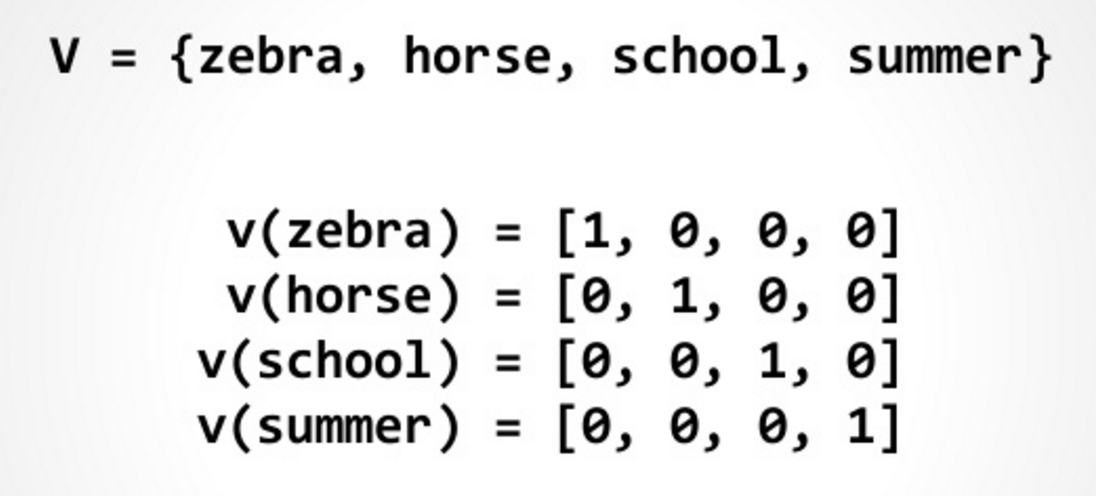
RNNs for Natural Language Processing
The natural input for a neural network is a vector of numeric values (e.g. pixel densities for imaging or audio frequency for speech recognition)
How do you feed language as input into a neural network?
The most basic solution is one hot encoding
A long vector (equal to the length of your vocabulary) where each index represents one word in the vocabulary
For each word, the index corresponding to that word is set to 1, and everything else is set to 0

Slide 24
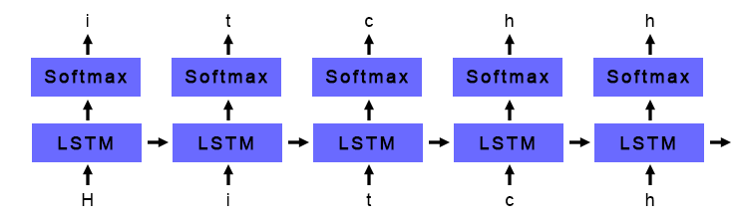
One Hot Encoding LSTM Example
Trained LSTM to predict the next character given a sequence of characters
Training corpus: All books in Hitchhiker’s Guide to the Galaxy series
One-hot encoding used to convert each character into a vector
72 possible characters – lowercase letters, uppercase letters, numbers, and punctuation
Input vector is fed into a layer of 256 LSTM nodes
LSTM output fed into a softmax layer that predicts the following character
The character with the highest softmax probability is chosen as the next character

Slide 25
Generated Samples
700 iterations: ae ae ae ae ae ae ae ae ae ae ae ae ae ae ae ae ae ae ae ae ae ae ae ae ae ae ae ae ae
4200 iterations: the sand and the said the sand and the said the sand and the said the sand and the said the sand and the said the
36000 iterations: seared to be a little was a small beach of the ship was a small beach of the ship was a small beach of the ship
100000 iterations: the second the stars is the stars to the stars in the stars that he had been so the ship had been so the ship had been
290000 iterations: started to run a computer to the computer to take a bit of a problem off the ship and the sun and the air was the sound
500000 iterations: "I think the Galaxy will be a lot of things that the second man who could not be continually and the sound of the stars

Slide 26
One Hot Encoding Shortcomings
One-hot encoding is lacking because it fails to capture semantic similarity between words, i.e., the inherent meaning of word
For example, the words “happy”, “joyful”, and “pleased” all have similar meanings, but under one-hot encoding they are three distinct and unrelated entities
What if we could capture the meaning of words within a numerical context?

Slide 27
Word Embeddings
Word embeddings are vector representations of words that attempt to capture semantic meaning
Each word is represented as a vector of numerical values
Each index in the vector represents some abstract “concept”
These concepts are unlabeled and learned during training
Words that are similar will have similar vectors
 | Masculinity | Royality | Youth | Intelligence
King | 0.95 | 0.95 | -0.1 | 0.6
Queen | -0.95 | 0.95 | -0.1 | 0.6
Prince | 0.8 | 0.8 | 0.7 | 0.4
Woman | 0.95 | 0.01 | -0.1 | 0.2
Peasant | 0.1 | -0.95 | 0.1 | -0.3
Doctor | 0.12 | 0. 1 | -0.2 | 0.95

Slide 28
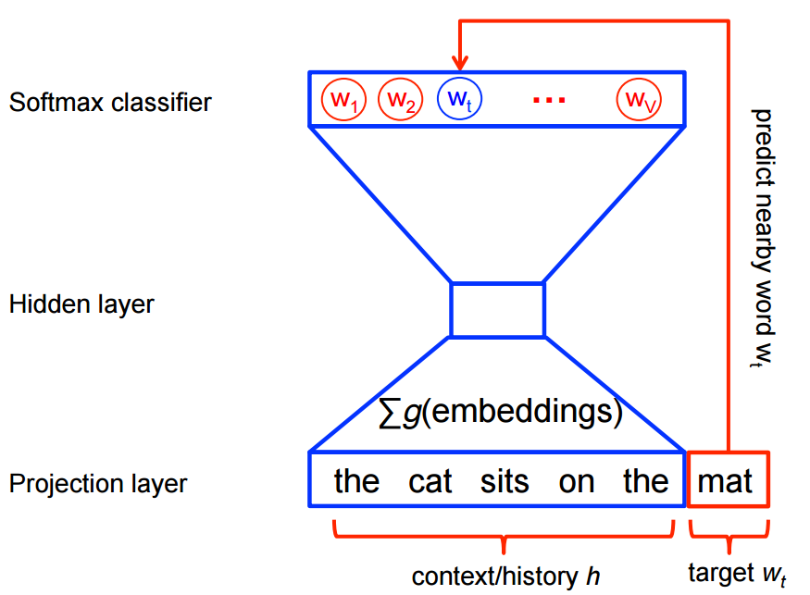
Word2Vec
Words that appear in the same context are more likely to have the same meaning
I am excited to see you today!
I am ecstatic to see you today!
Word2Vec is an algorithm that uses a funnel-shaped single hidden layer neural network to create word embeddings
Given a word (in one-hot encoded format), it tries to predict the neighbors of that word (also in one-hot encoded format), or vice versa
Words that appear in the same context will have similar embeddings

Slide 29
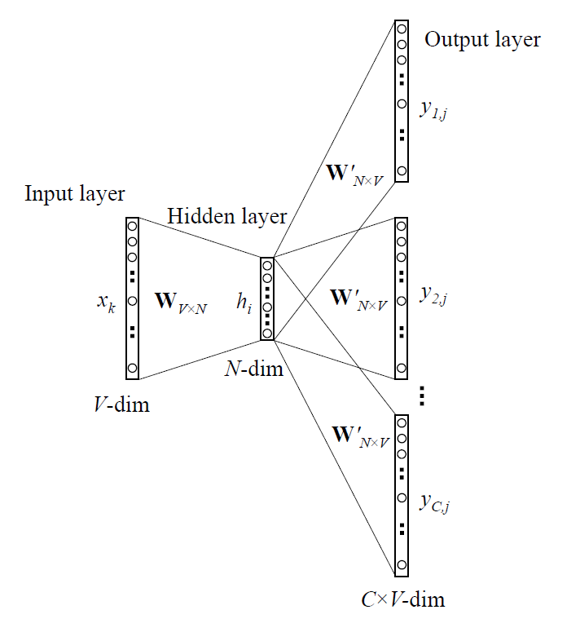
Word2Vec
The model is trained on a large corpus of text using regular backpropagation
For each word in the corpus, predict the 5 words to the left and right (or vice versa)
Once the model is trained, the embedding for a particular word is the row of the weight matrix associated with that word
Many pretrained vectors (e.g. Google) can be downloaded online

Slide 30
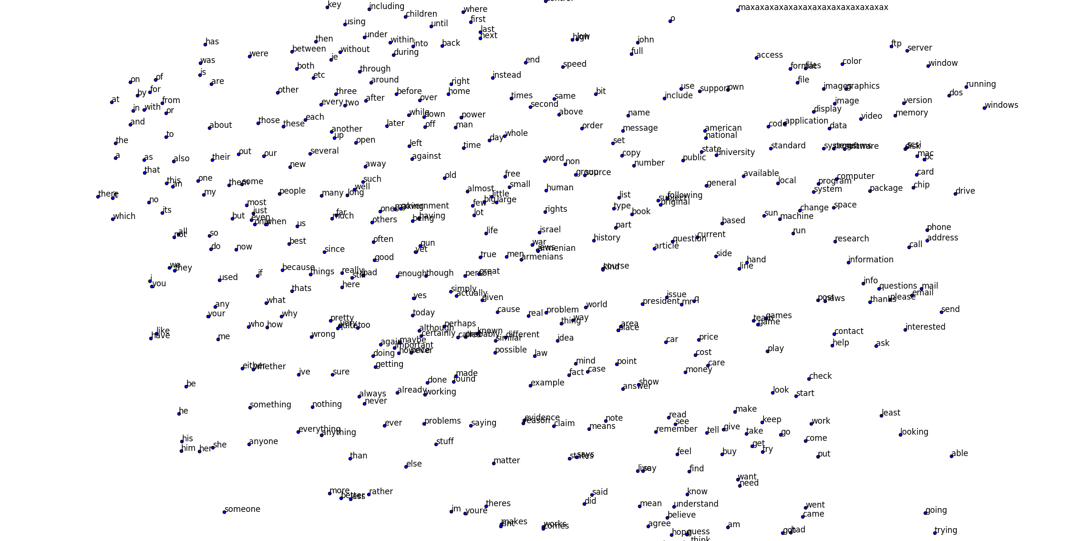
Word2Vec on 20 Newsgroups

Slide 31
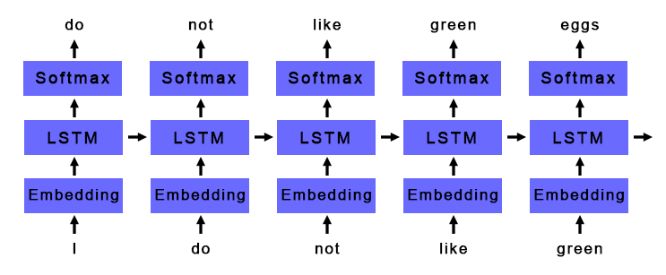
Basic Deep Learning NLP Pipeline
Generate Word Embeddings
Python gensim package
Feed word embeddings into LSTM or GRU layer
Feed output of LSTM or GRU layer into softmax classifier

Slide 32
Applications
Language Models
Given a series of words, predict the next word
Understand the inherent patterns in a given language
Useful for autocompletion and machine translation
Sentiment Analysis
Given a sentence or document, classify if it is positive or negative
Useful for analyzing the success of a product launch or automated stock trading based off news
Other forms text classification
Cancer pathology report classification

Slide 33
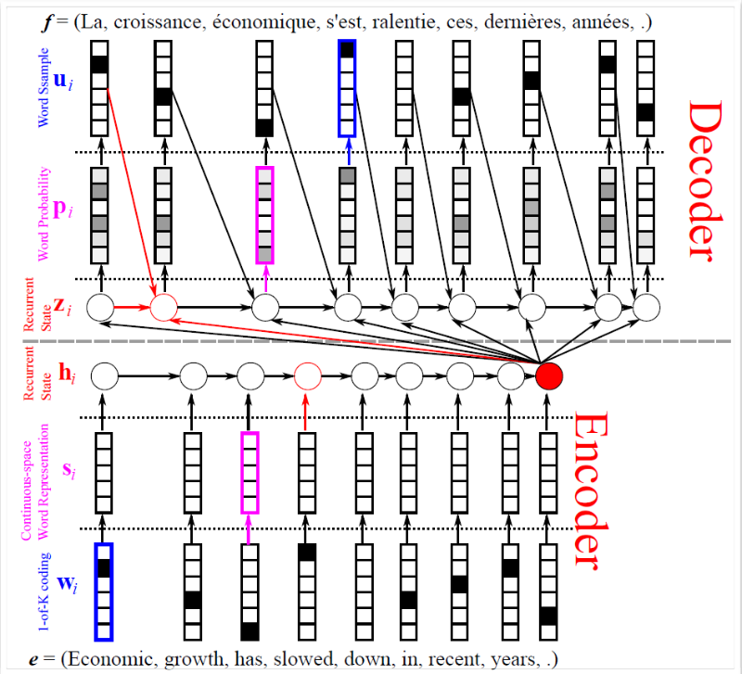
Advanced Applications
Question Answering
Read a document and then answer questions
Many models use RNNs as their foundation
Automated Image Captioning
Given an image, automatically generate a caption
Many models use both CNNs and RNNs
Machine Translation
Automatically translate text from one language to another
Many models (including Google Translate) use RNNs as their foundation

Slide 34
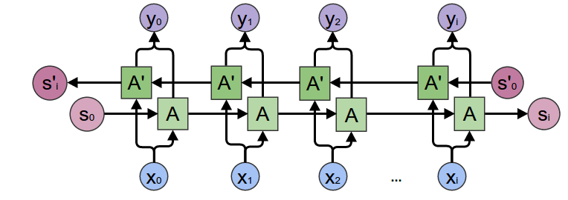
LSTM Improvements Bi-directional LSTMs
Sometimes, important context for a word comes after the word (especially important translation)
I saw a crane flying across the sky
I saw a crane lifting a large boulder
Solution - use two LSTM layers, one that reads the input forward and one that reads the input backwards, and concatenate their outputs

Slide 35
LSTM Improvements Attention Mechanisms
Sometimes only a few words in a sentence or document are important and the rest do not contribute as much meaning
For example, when classifying cancer location from cancer pathology reports, we may only care about certain keywords like “right upper lung” or “ovarian”
In a traditional RNN, we usually take the output at the last timestep
By the last timestep, information from the important words may have been diluted, even with LSTMs and GRUs units
How can we capture the information at the most important words?

Slide 36
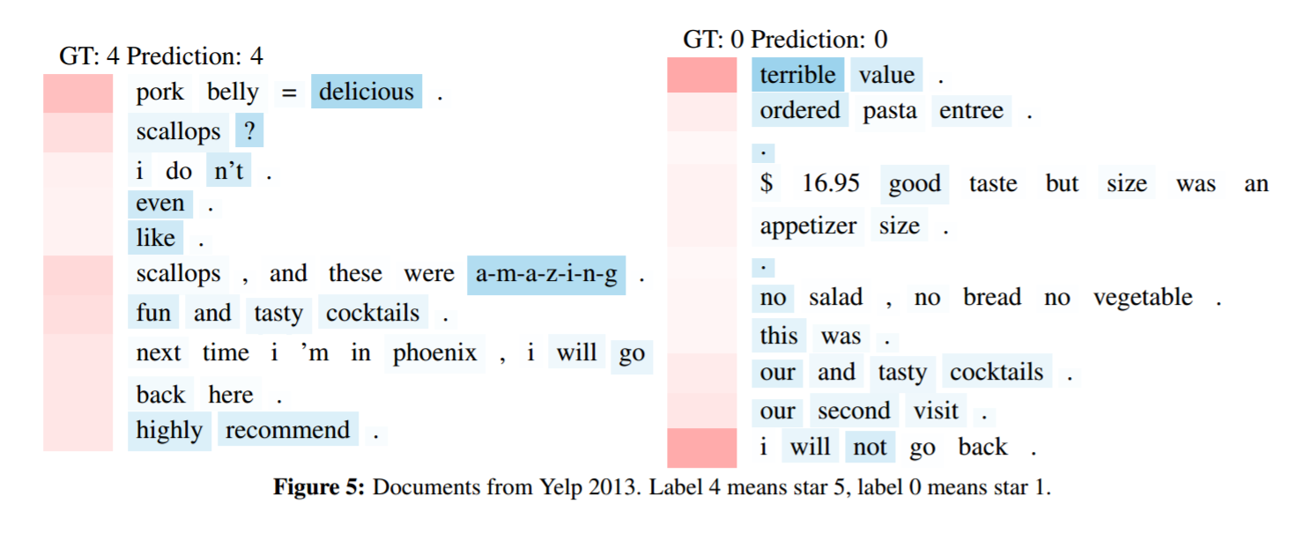
LSTM Improvements Attention Mechanisms
Naïve solution: to prevent information loss, instead of using the LSTM output at the last timestep, take the LSTM output at every timestep and use the average
Better solution: find the important timesteps, and weight the output at those timesteps much higher when doing the average

Slide 37
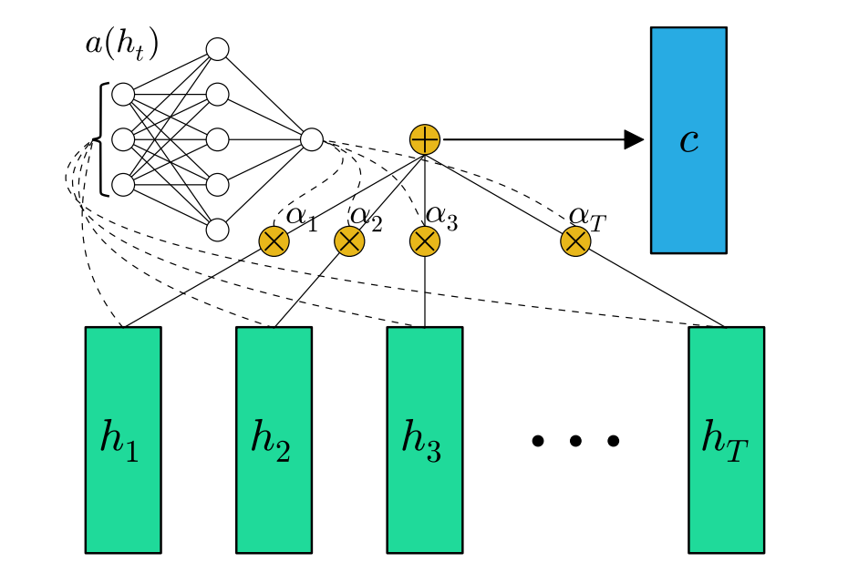
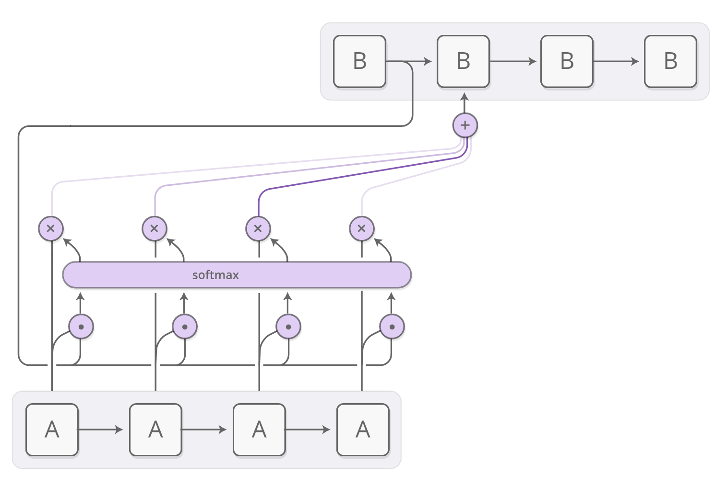
LSTM Improvements Attention Mechanisms
An attention mechanism calculates how important the LSTM output of each timestep is
It uses a single layer feedforward network with a softmax output
At each timestep, the output of the LSTM/GRU is fed into the feedforward network
The output of the feedforward network is a single value that is saved

Slide 38
LSTM Improvements Attention Mechanisms
Repeat for all timesteps in your segment (e.g. sentence, tweet, Yelp review)
Calculate a softmax over all saved outputs from the attention network to generate weights representing how important each timestep was
Multiply the output at each timestep with its importance and add to create a weighted average

Slide 39
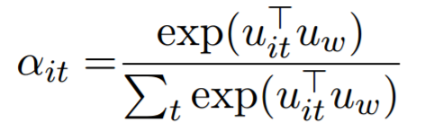
LSTM Improvements Attention Mechanisms
Attention mechanisms can take into account “context” to determine what’s important
Remember dot product is a measure of similarity – two vectors that are similar will have larger dot product
In normal softmax, dot product input with randomly initialized weights before applying softmax function

Slide 40
LSTM Improvements Attention Mechanisms
Instead, we can dot product with a vector that represents “context” to find words most similar/relevant to that context:
For question answering, can represent a question being asked
For machine translation, can represent the previous sentence
For classification, can be initialized randomly and learned during training

Slide 41
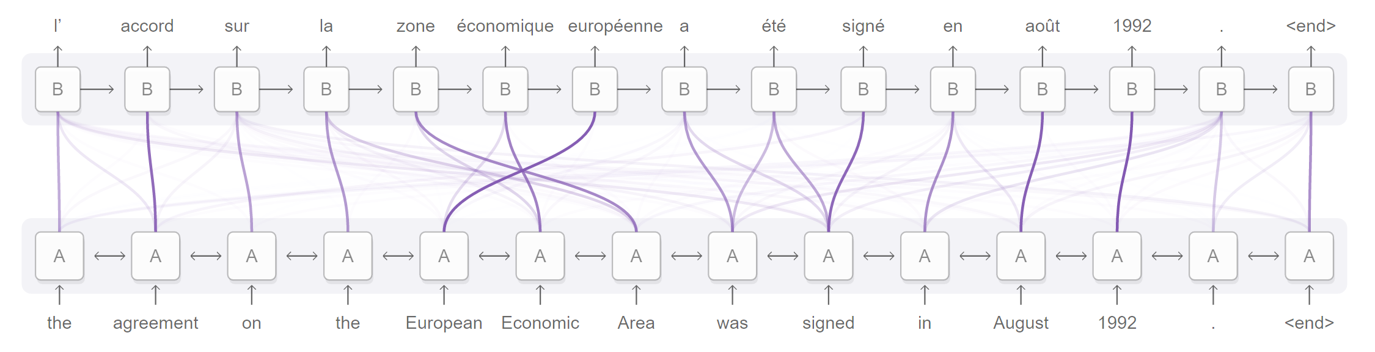
LSTM Improvements Attention Mechanisms
With attention, you can visualize how important each timestep is for a particular task

Slide 42
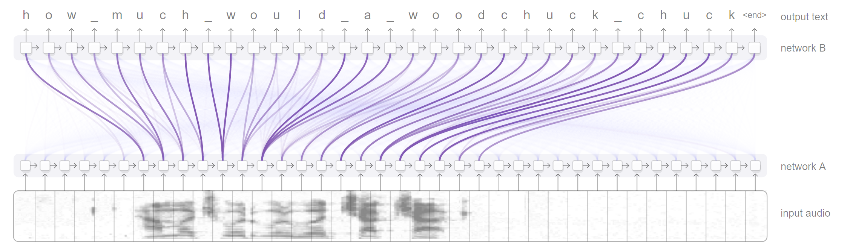
LSTM Improvements Attention Mechanisms
With attention, you can visualize how important each timestep is for a particular task

Slide 43
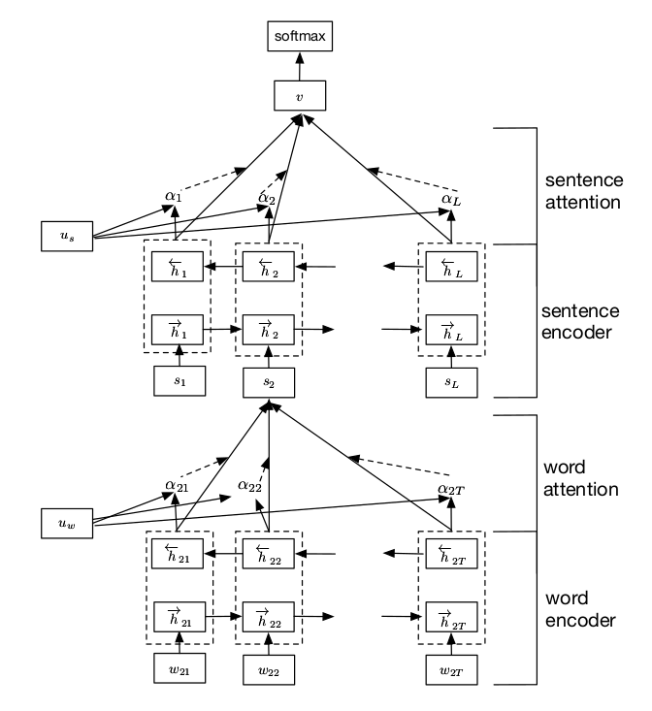
Hierarchical Attention Networks
Deep learning document classification model based on bidirectional LSTMs/GRUs with attention mechanisms
Composed of “hierarchies” where the outputs of the lower hierarchies become the inputs to the upper hierarchies

Slide 44
Hierarchical Attention Networks
The model has two "hierarchies“
The lower hierarchy processes one sentence at a time
The words in the sentence are fed into a bidirectional LSTM as word2vec embeddings
The LSTM outputs are fed into an attention mechanism that determines which words are most important
The final output is a weighted embedding that represents the meaning of the sentence
This is repeated for every sentence in the document

Slide 45
Hierarchical Attention Networks
The model has two "hierarchies“
The upper hierarchy processes the entire document
The sentence embeddings from the lower hierarchy are fed into a bidirectional LSTM
The LSTM outputs are fed into an attention mechanism that determines which sentences are most important
The final output is a weighted embedding that represents the meaning of the entire document
This embedding is fed into a final softmax classifier

Slide 46
HAN Performance
~1000 cancer pathology reports, all cases of breast and lung cancer
Two main tasks – primary site classification and histological grade classification
10 – fold cross validation used, 30 epochs per fold
HAN takes approximately 6 hours to train per fold on an Nvidia Titan GPU
3 days total to do 10-fold cross validation
RNNs can take a long time to train because of backpropagation through many timesteps
LSTMs/GRUs and attention mechanisms increase the complexity of the backpropagation
In comparison, CNN takes around 20 minutes per fold on same data

Slide 47
HAN Performance – Primary Site
12 possible cancer locations
Uneven class distribution, some with only ~10 occurrences in dataset
F-score used for performance metric
Micro F-score is weighted F-score average based on class size
Macro F-score is unweighted F-score average across all classes
Performance comparison – Micro/Macro F-Score
Naïve Bayes: [redacted]
Random Forests: [redacted]
XG-Boost: [redacted]
CNN: [redacted]
HAN: [redacted]

Slide 48
HAN Performance – Histology
4 possible histological grades
1-4, indicating how abnormal tumor cells and tumor tissues look under a microscope with 4 being most abnormal
Indicates how quickly a tumor is likely to grow and spread
Performance comparison – Micro/Macro F-Score
Naïve Bayes: [redacted]
Random Forests: [redacted]
XG-Boost: [redacted]
CNN: [redacted]
HAN: [redacted]

Slide 49
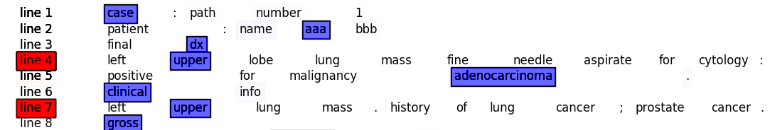
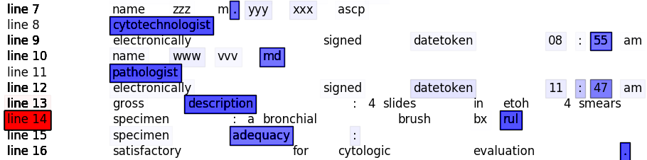
HAN Visualizations
Thanks to attention, we can visualize the most important words in each line as well as the most important lines in each document

Slide 50
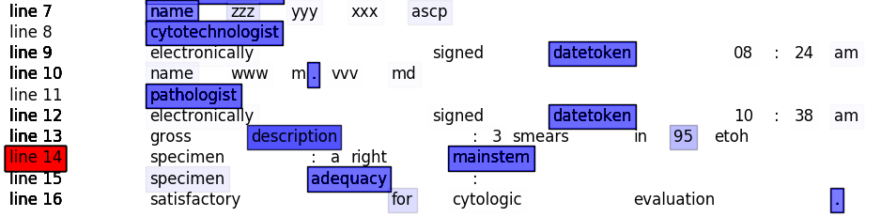
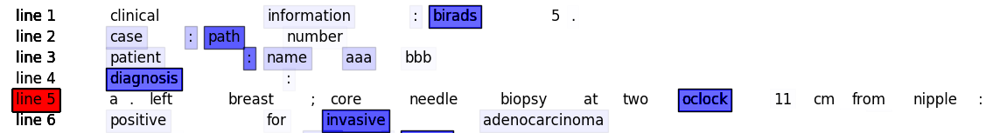
HAN Visualizations
Thanks to attention, we can visualize the most important words in each line as well as the most important lines in each document

Slide 51
HAN Visualizations
We can also use attention to find the words that contribute most towards the classification task at hand:
sternal
temporal
subcarina
arm
mainstem
liver
breast
upper
carina
lower
middle
frontal
lingula
oclock
ovarian
lll
lul
lung
iliac
rul

Slide 52
What’s Next?
Scaling model to utilize multiple GPUs to improve runtime
We are receiving a much larger dataset in the summer (possibly tens or hundreds of thousands of reports)
Don’t want to wait weeks for model to train
Utilize semi-supervised learning to train model
About twice as much unlabeled reports as labeled ones
Would like to be able to use unlabeled data to train the model
One possibility is pretraining the network using sequence to sequence autoencoders, i.e., given a document, create a document embedding, then reconstruct the original document from that embedding
Ladder networks utilize the same principle but can perform supervised/unsupervised training simultaneous by combining both networks into a single architecture

Slide 53
Questions? https://github.com/iamshang1/Projects

